Slide 1
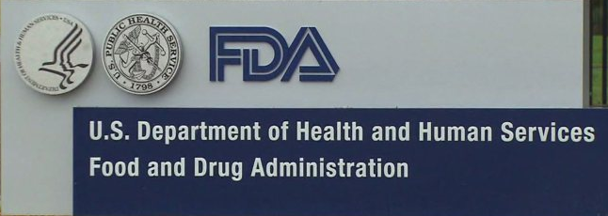

Roche UDI (Unique Device Identification) Process
Group: 5
Sahil Sikka Supreet Mangat Suvir Gupta

Slide 2
Roche: Pharma company
Roche: a pioneer in the discovery, development, production and marketing of novel healthcare solutions
Roche is one of the world’s leading research-focused healthcare groups in the fields of pharmaceuticals and diagnostics
Established in 1896
Major business: 2 division – Pharma and Diagnostic
Headquarters: Basel, Switzerland
Number of employees: 88,509

Slide 3
Roche Equipment Pharma company
FDA classification of medical equipment or devices based on risk they pose to consumers
Changes in FDA Regulations
Registration of Type III product in form of UDI (Unique Device Identification)
Link internal company’s database with FDA database using unique identifier
Advantages of UDI
Helps end user to acquire device information
Improve the accuracy reporting of adverse events
Type – I 1. Low to moderate risk 2. General controls
Type – II 1. Moderate to high risk 2. General & specific controls
Type – III 1. High risk 2. General controls and Pre-market approval

Slide 4
Data Governance
In this project, we studied the “Data Governance” process of Roche
Components of the Business Process:
Inter-related Tasks
Equipment Specifications identified
Data Owner Assigned
Data Owner: Creates/Updates/Delete the required data
Data Approver: Validates the data
Triggering Event
Periodic Data Management Process
Specific Result
The DB is updated
Customer
FDA
Stakeholders
Pharma companies, FDA, Physicians, Patients

Slide 5
As-is-process

Slide 6
Issues
New FDA regulation: All Pharma companies need to share data with the following new attributes for all the type 3 equipment it manufactures or market:
Issuing Agency
Primary Device Identifier
Device Count
Registered Brand Name in Agency
Model Number
Packaging Type
In order to comply with this new regulation, the company to create an additional database with extensive Approval Process for all the Type-3 Equipment.

Slide 7
Enablers
Workflow Design: A new workflow has to be created in order to comply with new FDA Regulations
Information Systems: User interface applications in order to implement the workflow process
Human Resources: Regulatory Department, Launch Managers, Product Managers, Data Owners, Project Managers, Data Approvers & Data Coordinator.
Policies and Rules
The ‘Change Request’ process has to be completed at least 10 days before the FDA specified deadlines
Any system related issues needs to be immediately reported to the I.T department

Slide 8
Data Model

Slide 9
To-Be Process

Slide 10
Depiction of Work Flow
Add Material Data
Maintain& Forward
Check & Forward
Submit for approval
Regulator
Launch Manager
Product Manager
Data Owners
Send for Approval
Reject
Release
Approve
Data approver
Reject
UDI Coordinator
External Regulatory

Slide 11
Workflow Description
Workflow steps:
Regulatory creates CR request
Regulatory assigns data to launch manager in work flow table
Launch Manager checks for the related attributes in DMA and email them to product Manager
Product Manager checks the attributes to be created and assign the closing date to equipment Id
Product manager assign data owner to create the FDA specified attributes
Data owner creates data in the type 3 equipment table
Product/Project Manager assigns data validator to the workflow table
Data validator validates the data and marks the data as approved in workflow table

Slide 12
Demonstration of Database
Database Script
Demonstration Of Scenario
Queries
New SQL function (trigger and sequence)

Slide 13


